Slide 1
Database
Management System
Lecture - 03

Slide 2
Database Model
Database model defines the logical design of data.
Database model describes the relation between different
parts of data.
There are three database models:
    Hierarchical Model
    Network Model
    Relational Model

Slide 3
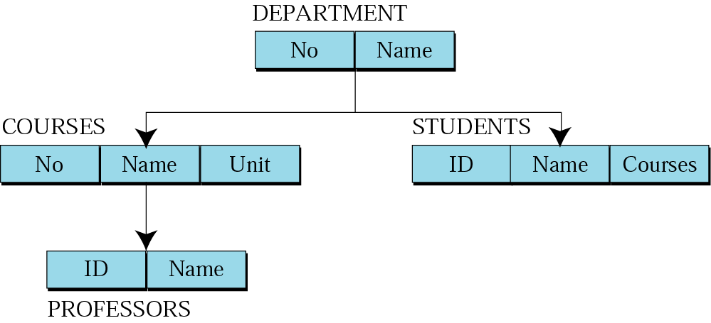
Hierarchical Model
Data are organized in an upside down tree
Each entity has one parent and many children
Old and not used now

Slide 4
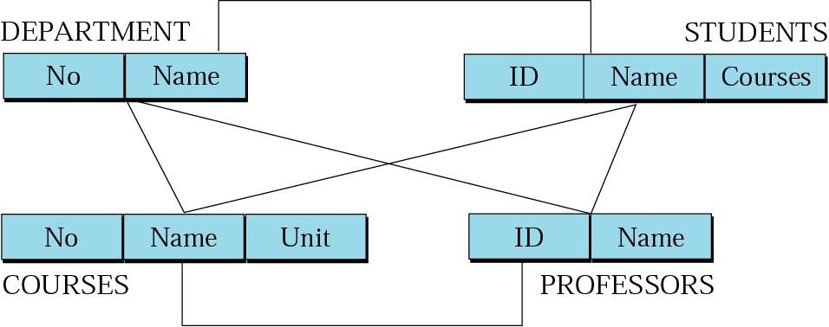
Network Model
Entities are organized in a graph
Entities can be accessed through several paths
Old and not used

Slide 5
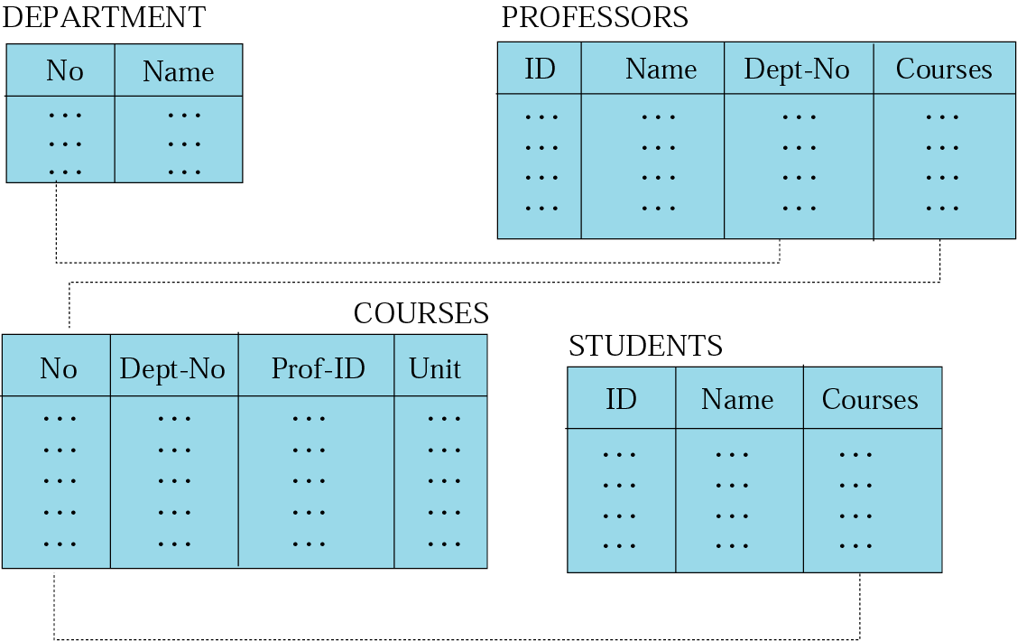
Relational Model
Data are organized in two dimensional tables (relations)
Tables related to each other
Relational Database Management System (RDBMS) are more common model used today

Slide 6
Logical Database Design

Slide 7
Introduction to Relational Data Model

Slide 8
Relational Data Model
Presented by E. F. Codd in 1970, then of IBM
Before Relational Data Model, two older data models were in use; Hierarchical, Network

Slide 9
Relational Data Model
First DBMS built on Relational Data Model (RDM) was system R
Another Relational DBMS built during those days was INGRES

Slide 10
Basic of RDM
RDM used mainly for external, conceptual, and to some extent physical schema
Separation of conceptual and physical levels makes manipulation much easier, contrary to previous data models

Slide 11
Basic of RDM
RDM used for external, conceptual, and to some extent physical schema
The basic structure is relation
Both entities and relationships are modeled using tables/relations

Slide 12
Basics of RDM
Relations physically represented as tables
Table is a two dimensional representation of a relation
Consists of rows and columns

Slide 13
Basics of RDM
Columns represent attributes and rows represent records
Rows, records and tuples all these terms are used interchangeably

Slide 14
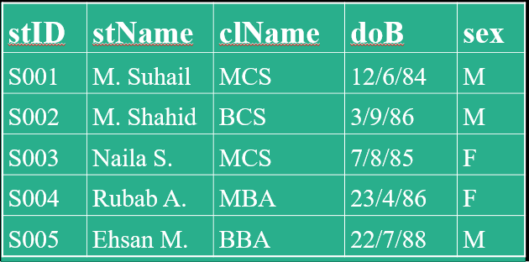
Basic Properties of a Table
Each cell of a table contains atomic/single value
Each column has a distinct name; the name of the attribute it represents

Slide 15
Basic Properties of a Table
The values of the attributes come from the same domain
The order of the columns is immaterial

Slide 16
Basic Properties of a Table
The order of the rows is immaterial
Each row/tuple/record is distinct, no two rows can be same

Slide 17
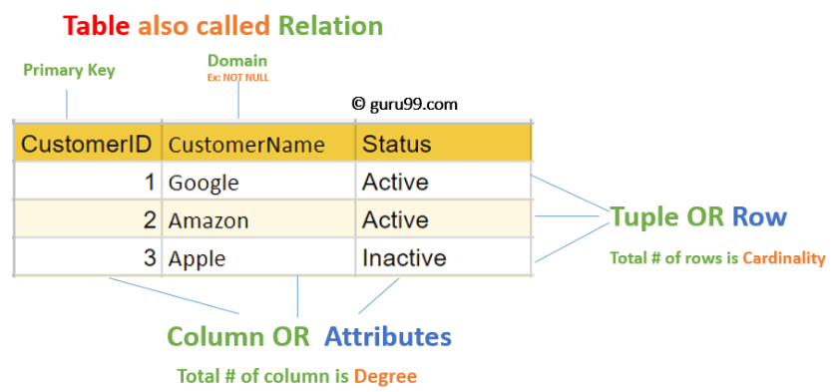
A Table
Customer Relation

Slide 18
RM Concept in DBMS
Attribute: Each column in a Table. Attributes are the properties which define a relation. e.g., Student_Rollno, NAME,etc
Tables – In the Relational model the, relations are saved in the table format. It is stored along with its entities. A table has two properties rows and columns. Rows represent records and columns represent attributes.
Tuple – It is nothing but a single row of a table, which contains a single record.

Slide 19
RM Concept in DBMS
Relation Schema: A relation schema represents the name of the relation with its attributes.
Degree: The total number of attributes which in the relation is called the degree of the relation.
Cardinality: Total number of rows present in the Table.
Column: The column represents the set of values for a specific attribute.
Relation instance – Relation instance is a finite set of tuples in the RDBMS system. Relation instances never have duplicate tuples.

Slide 20
RM Concept in DBMS
Relation key – Every row has one, two or multiple attributes, which is called relation key.
Attribute domain – Every attribute has some pre-defined value and scope which is known as attribute domain
Relational database schema – A set of relation schemas ,each with a distinct name.
Example: If R1,R2,R3…..Rn are set of relations, then we can write RDBMS as
R={ R1,R2,R3…..Rn}

Slide 21
Relational Integrity Constraints
Relational Integrity constraints in DBMS are referred to conditions which must be present for a valid relation. These Relational constraints in DBMS are derived from the rules in the mini-world that the database represents.
There are many types of Integrity Constraints in DBMS. Constraints on the Relational database management system is mostly divided into three main categories are:
Domain Constraints
Key Constraints
Referential Integrity Constraints

Slide 22
Domain Constraints
Create DOMAIN CustomerName CHECK (value not NULL)
Domain constraints can be violated if an attribute value is not appearing in the corresponding domain or it is not of the appropriate data type.
Domain constraints specify that within each tuple, and the value of each attribute must be unique. This is specified as data types which include standard data types integers, real numbers, characters, Booleans, variable length strings, etc.
Example:
create DOMAIN CustomerName
check( value not null)

Slide 23
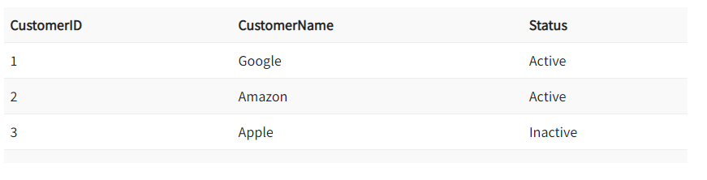
Key Constraints
Create DOMAIN CustomerName CHECK (value not NULL)
An attribute that can uniquely identify a tuple in a relation is called the key of the table. The value of the attribute for different tuples in the relation has to be unique.
Example: In the given table, CustomerID is a key attribute of Customer Table. It is most likely to have a single key for one customer, CustomerID =1 is only for the CustomerName =” Google”.

Slide 24
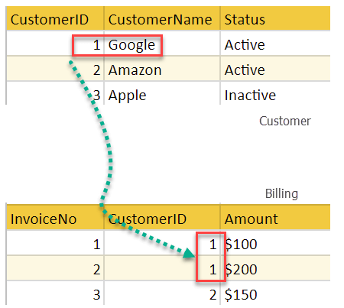
Referential Integrity Constraints
Create DOMAIN CustomerName CHECK (value not NULL)
Referential Integrity constraints in DBMS are based on the concept of Foreign Keys. A foreign key is an important attribute of a relation which should be referred to in other relationships. Referential integrity constraint state happens where relation refers to a key attribute of a different or same relation. However, that key element must exist in the table.
Example :
In the above example, we have 2 relations, Customer and Billing.
Tuple for CustomerID =1 is referenced twice in the relation Billing. So we know CustomerName=Google has billing amount $300

Slide 25
Components of RDM
As discussed in data model definition
  Structure (relation/table)
  Integrity constraints

Slide 26
Advantages of Relational Database Model
Simplicity: A Relational data model in DBMS is simpler than the hierarchical and network model.
Easy to use: The Relational model in DBMS is easy as tables consisting of rows and columns are quite natural and simple to understand
Data independence: The Structure of Relational database can be changed without having to change any application.

Slide 27
Disadvantages of Relational Model
Relational databases can sometimes become complex as the amount of data grows, and the relations between pieces of data become more complicated.
Complex relational database systems may lead to isolated databases where the information cannot be shared from one system to another.

Slide 28
Database
Management System
Lecture – 03
END

